Slide 1
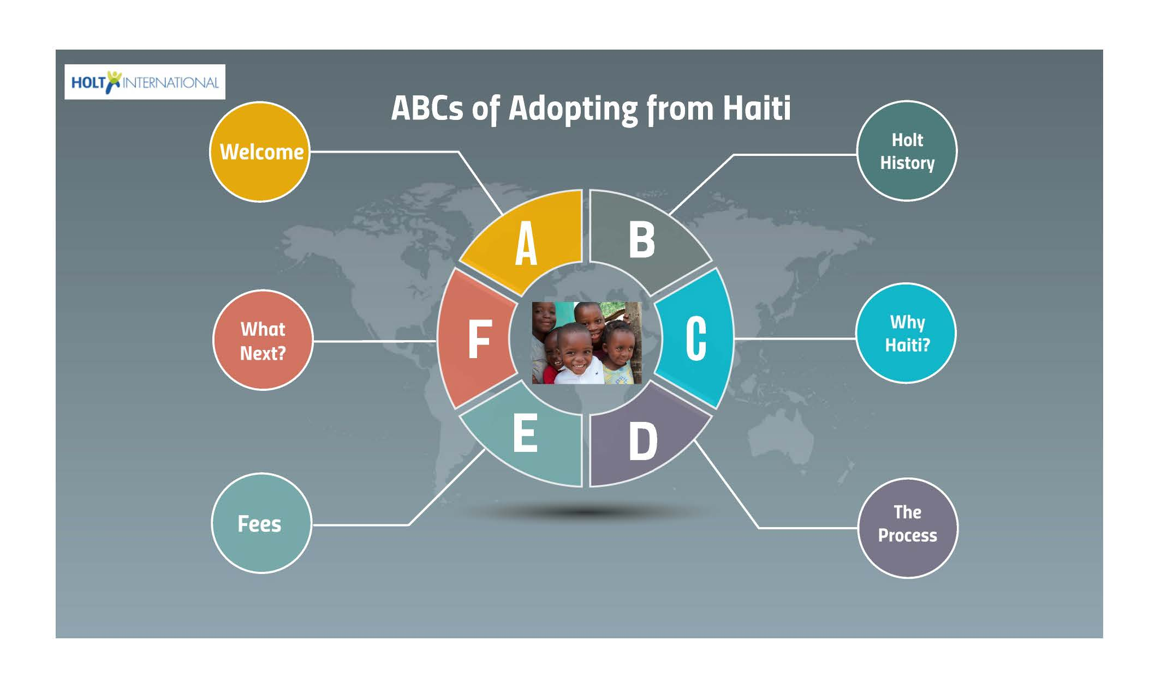

Notes:
On behalf of Holt International, I would like to formally welcome you to the ABCs of Adopting from Haiti presentation. My name is Amanda Colonia and I am the Adoption’s Case Manager for Holt’s Haiti Program.

Slide 2
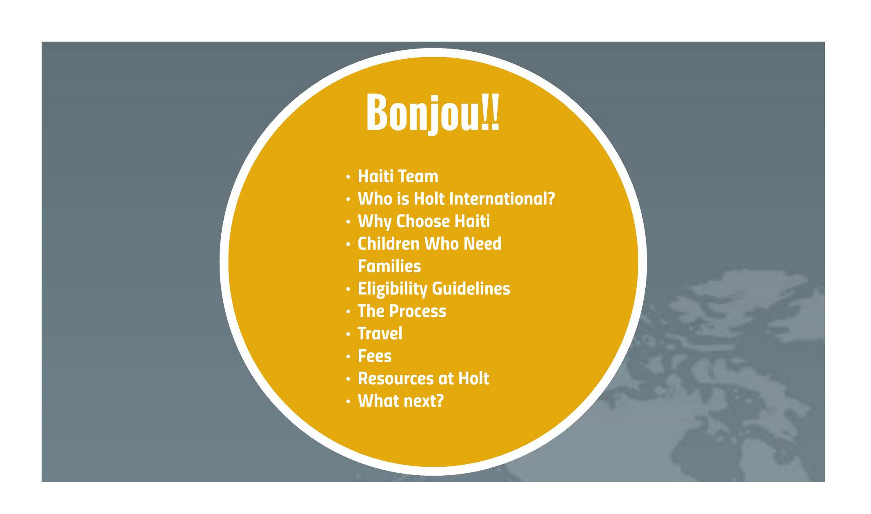
Notes:
We hope that this training is helpful to your family. The outline for today is pretty straight forward. We want to provide you with an overview of our Haiti program, including the profile of children in need of families, eligibility requirements, a general process overview, travel, costs associated with adoption from Haiti, as well as resources.

Slide 3

Notes:
Holt has over a 60 year history in working in the areas of child welfare and adoption all around the world.

Slide 4
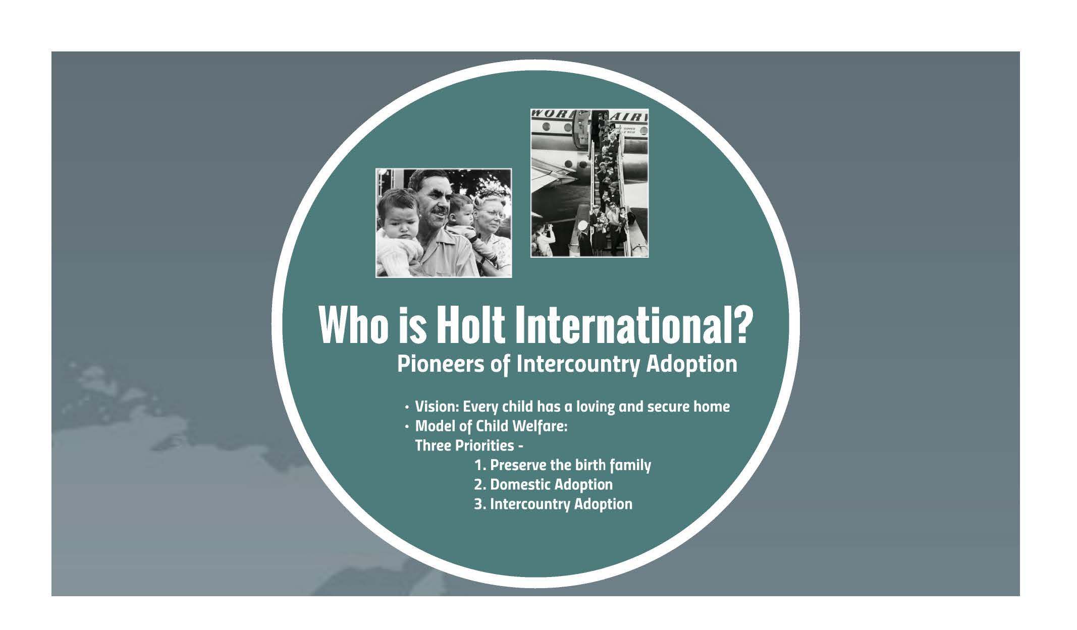
Notes:
A great place to start to get to know Holt better is through our mission statement. While always upholding the highest ethical standard, we:
Find and support permanent, loving families for children who are orphaned, abandoned or at serious risk of separation from their families.
Provide services to ensure that children will grow and develop to their fullest potential.
Lead the global community in advocating on behalf of the world’s most vulnerable children.
This mission started back in the 1950’s with Harry and Bertha Holt. This Oregon couple already had 6 biological children when they watched a World Vision film about the children left vulnerable after the Korean War. Harry and Bertha were very moved by what they learned and started sponsoring children in order to help provide support for food, clothing and medical care. But they felt in their hearts that while sponsoring children was making a difference, it was not meeting the most important need for every child to have a home and family of their own. Harry travelled to Korea while Bertha stayed in Oregon to research how to go about an unprecedented international adoption process. Her unwavering efforts paid off because Congress passed an act that would eventually allow them and other American families the ability to adopt internationally.
What the Holt’s did was revolutionary for the 1950’s because they shattered the culture of secrecy that had surrounded adoption in the U.S. Agencies previously had worked hard to ensure that adopted children physically resembled the family they were placed with so no one had to know the child was adopted. When the Holt’s moved forward with their adoption of 8 Korean children, who obviously looked different from them, it brought adoption out into the open and presented a different way for families to be formed. The Holt’s story inspired families across the United States to contact Harry and Bertha and those families began asking how they could also adopt from Korea. Through a grass roots effort to try and help unite Korean children in need of homes with these families, the Holt agency was formed, which has evolved into Holt International Children’s Services as we know it today.
Though we've grown, our ideals have remained constant. Our approach is child centered. We still believe the best care comes from a loving family, and we always explore the possibility of reuniting Holt children first with their birth families.
Our passion and purpose is to give all children the love they need and deserve through a family of their own, whether by birth or by adoption – to a domestic family or a family in the United States.

Slide 5

Notes:
Haiti is a country that is ratified under the Hague. Currently, Holt partners with the Haitian Central Authority known as IBESR which translates as the Institute of Social Welfare and Research. IBESR oversees all child welfare in the country of Haiti, including family reunification, domestic adoption and intercountry adoption. Additionally, Holt employs a very dedicated staff who work at our office in Port Au Prince to facilitate work surrounding all of Holt’s core pillars, including intercountry adoption.

Slide 6
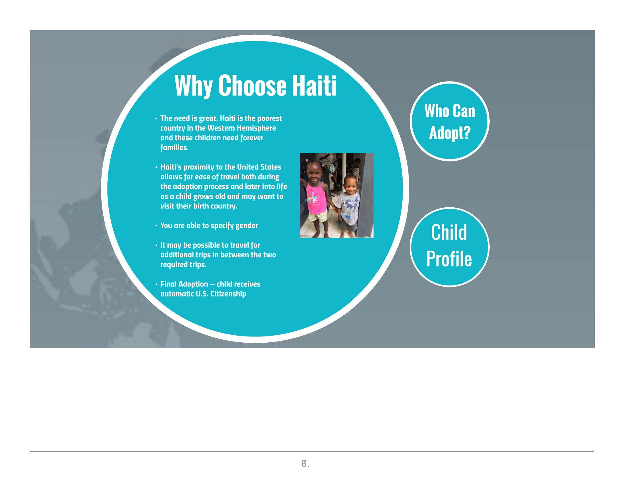
Notes:
So why choose to adopt a child from Haiti? There are many great reasons, but one of the biggest is that there are currently children in Haiti who are in need of families!
Holt has 60 years of knowledge and expertise working in child welfare and adoption. The need in Haiti is very great. Haiti is the poorest country in the Western Hemisphere and these children need forever families. Haitian are a beautiful people, resilient and full of hope.
Haiti joined the Hague Convention in 2014, which creates safeguards throughout the international adoption process. Children reside in crèches, or orphanages, which must be licensed by the Haitian government.
Haiti’s proximity to the United States allows for ease of travel both during the adoption process. If your family has the extra time and the financial resource, you are currently allowed to make extra trips in between the two required trips. Each trip allows for a more gradual initial transition in order to build a strong bond between you and your child. We’re consistently amazed at how well children transition over to the physical custody of their adoptive parents during the second trip because they’ve previously met and spent time with their adoptive family during the first trip.

Slide 8
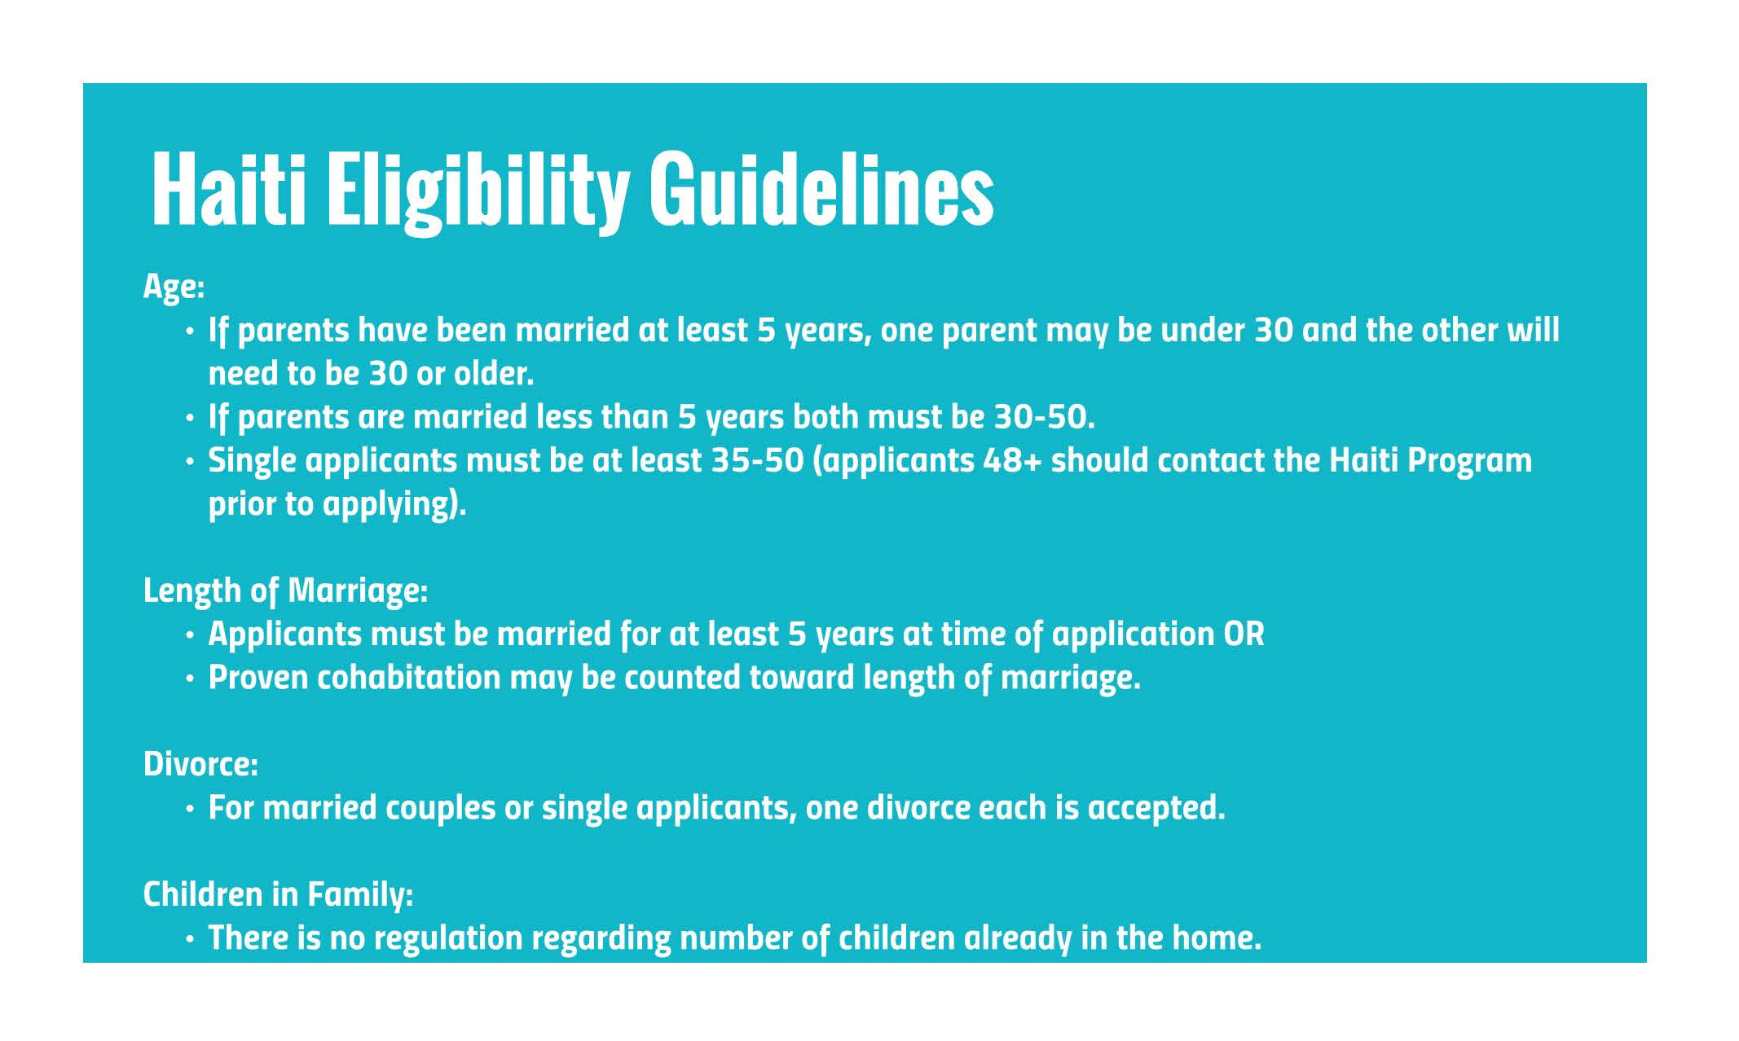
Notes:
Now we’ll move on to Eligibility Requirements. Requirements are set by several entities, including your homestudy agency, your state of residence, the US Government (USCIS), Holt USA, IBESR (Haiti’s Central Authority) as well as the Haitian Government at large. Haiti’s eligibility requirements are somewhat lax in regards to age of prospective adoptive parents, generally between the ages of 30 – 50, and single women who are 35 and older are encouraged to apply.

Slide 10
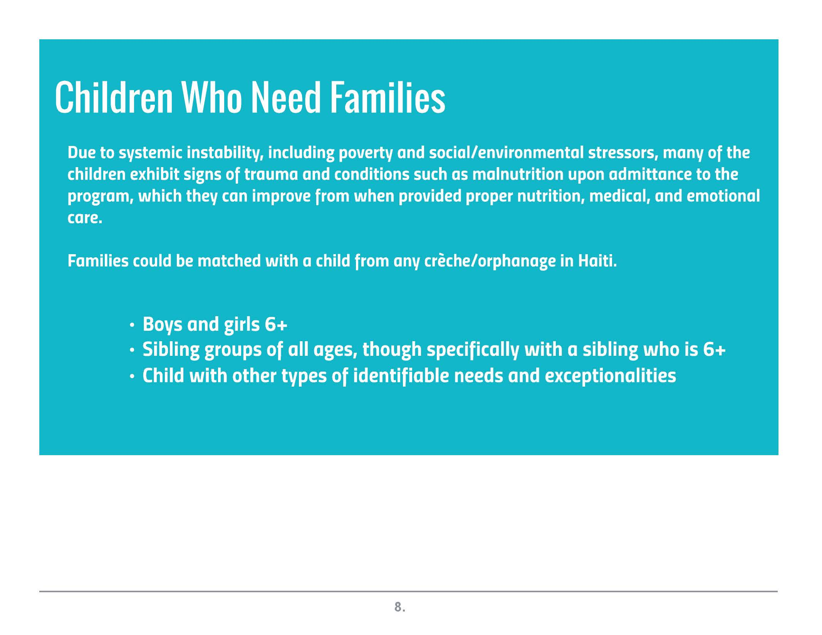
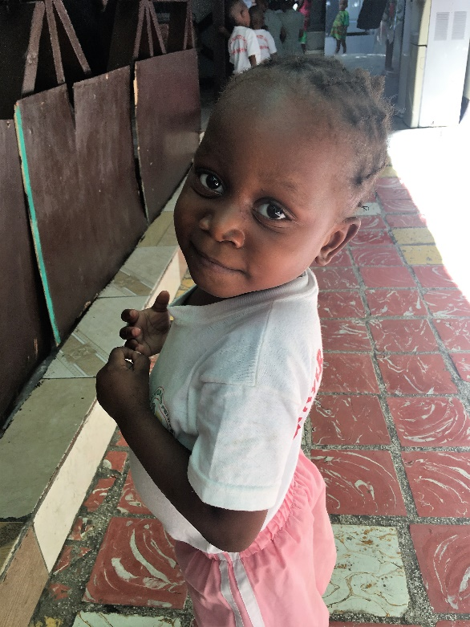
Notes:
Children in Haiti come into care through relinquishment and through abandonment. Children are placed in creches, or orphanages. The creches take the child through a legal process, by which a child dossier is created and then sent to IBESR, to move the child onto the adoption track. IBESR then matches the child dossier with a family dossier sent from Holt and proposes that match. Most children are matched between the ages of 2 – 13, however children who are 6 and older are more widely available to be adopted. Both boys and girls are available for adoption. There is also a high degree of need for adoptive parents who are open to adopting sibling groups and to adopting children with more moderate degrees of medical and other types of special needs. Due to systemic instability, including poverty, many children exhibit signs of trauma, which parents should be prepared for.

Slide 11


Slide 12
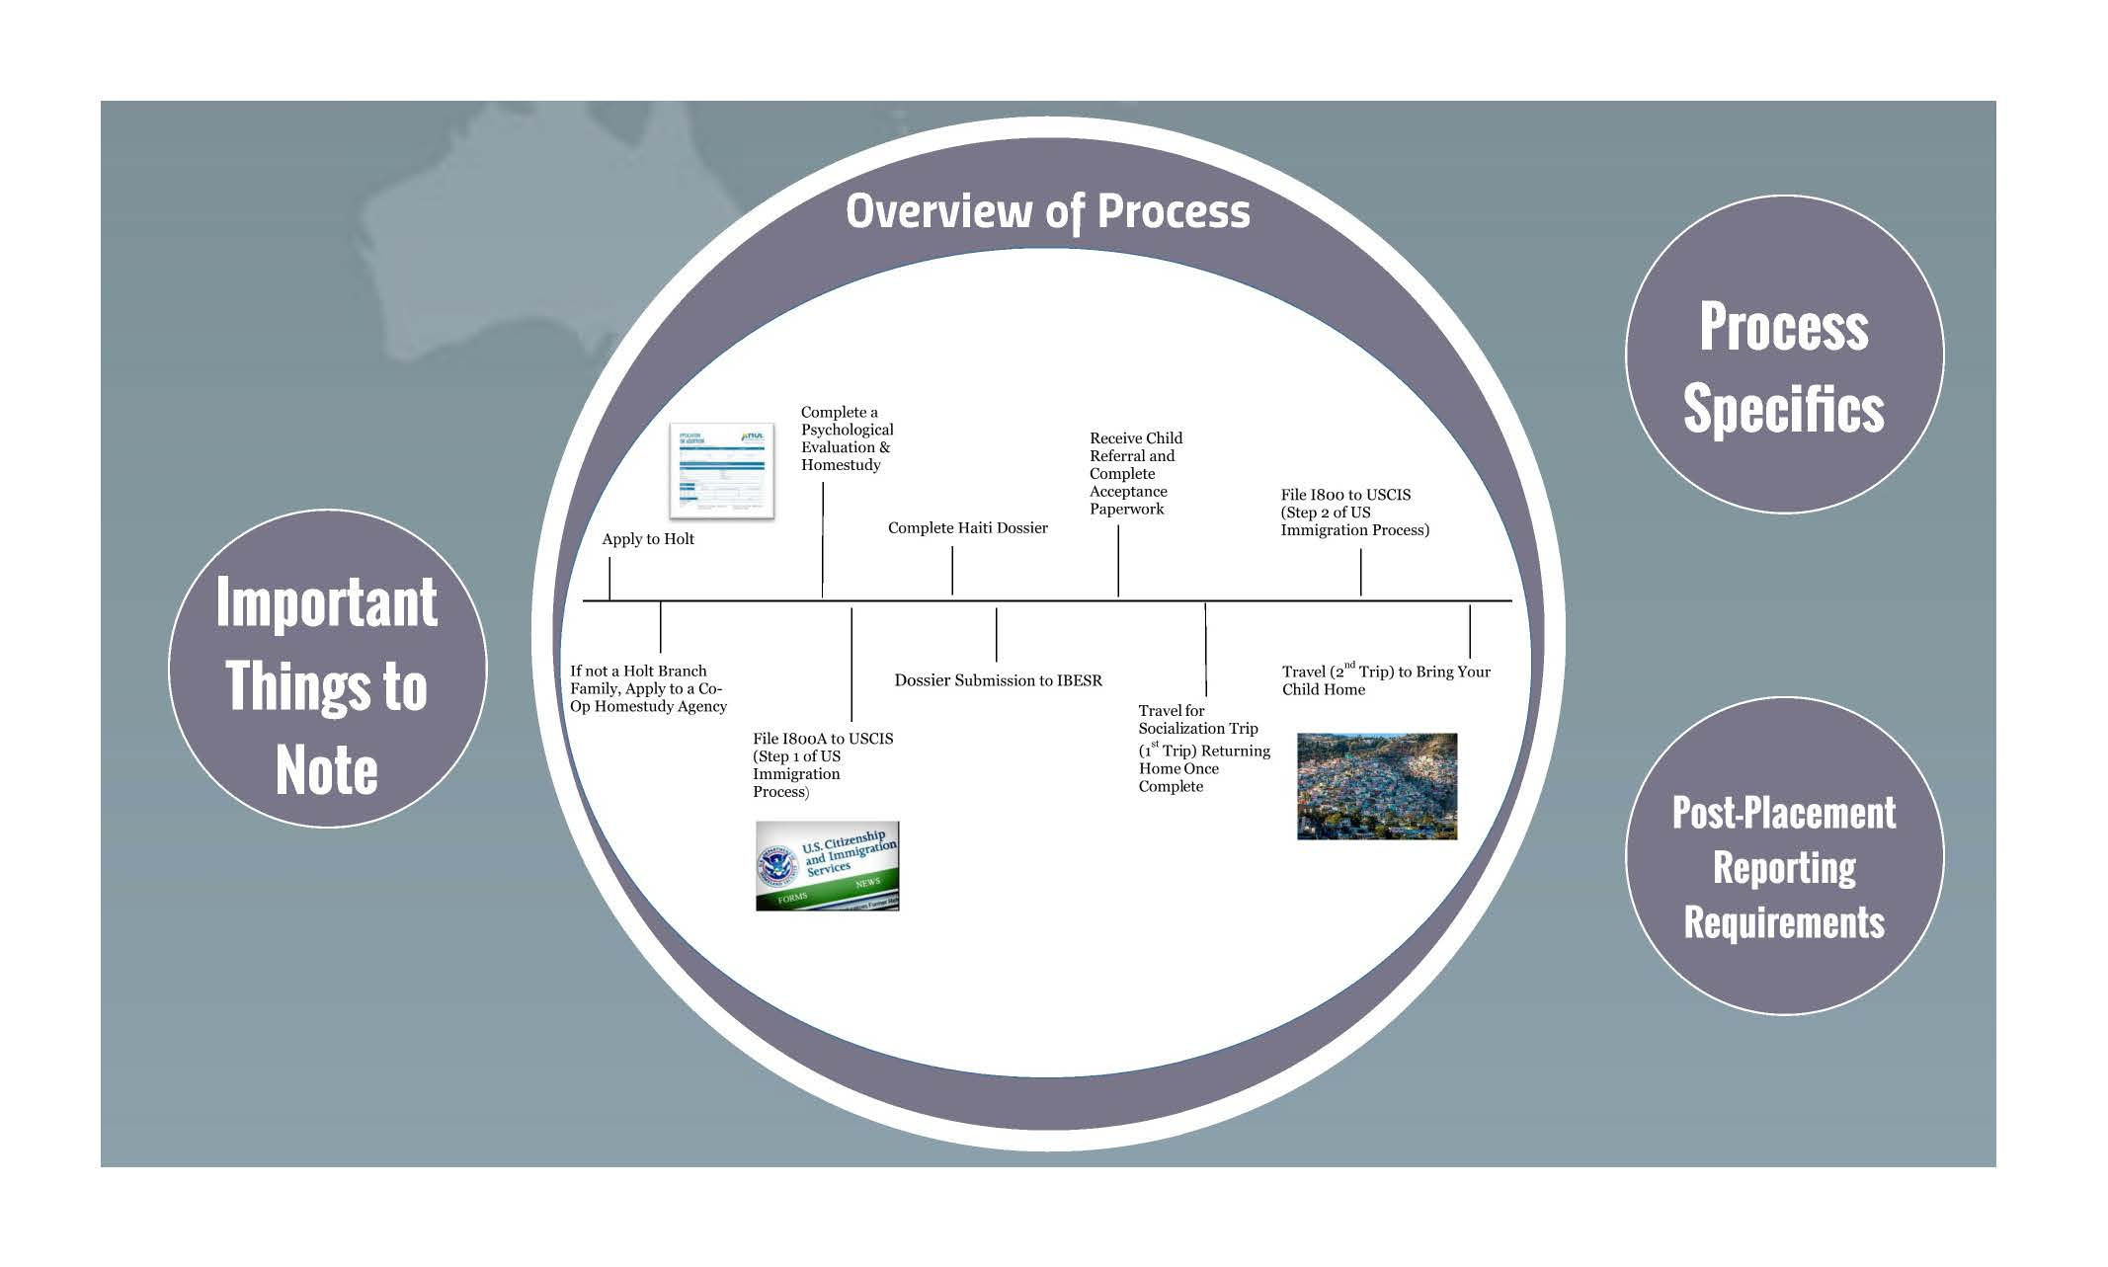
Notes:
Now, to the adoption process itself. First, your family applies to Holt. It can take a family anywhere from 3-4 months to complete your HS, depending upon each state and your family’s pace at completing your paperwork. If you live in a non-Holt Branch state, again, you will need to work with one of Holt’s partner home study agencies that is Hague Accredited, as this is a requirement when adopting from Haiti. As a part of the homestudy assessment, families will complete a psychological evaluation. You will also work on your dossier documents concurrently. You will want to be mindful of the timeframe though, as several documents expire after 6 months and we don’t want you to have to re-do documents. Your homestudy is just one component of your dossier, so after your family receives your approved HS, you will finish compiling your dossier. You will then get the dossier state-certified, translated into French and authenticated at the Haitian Consulate.

Slide 14
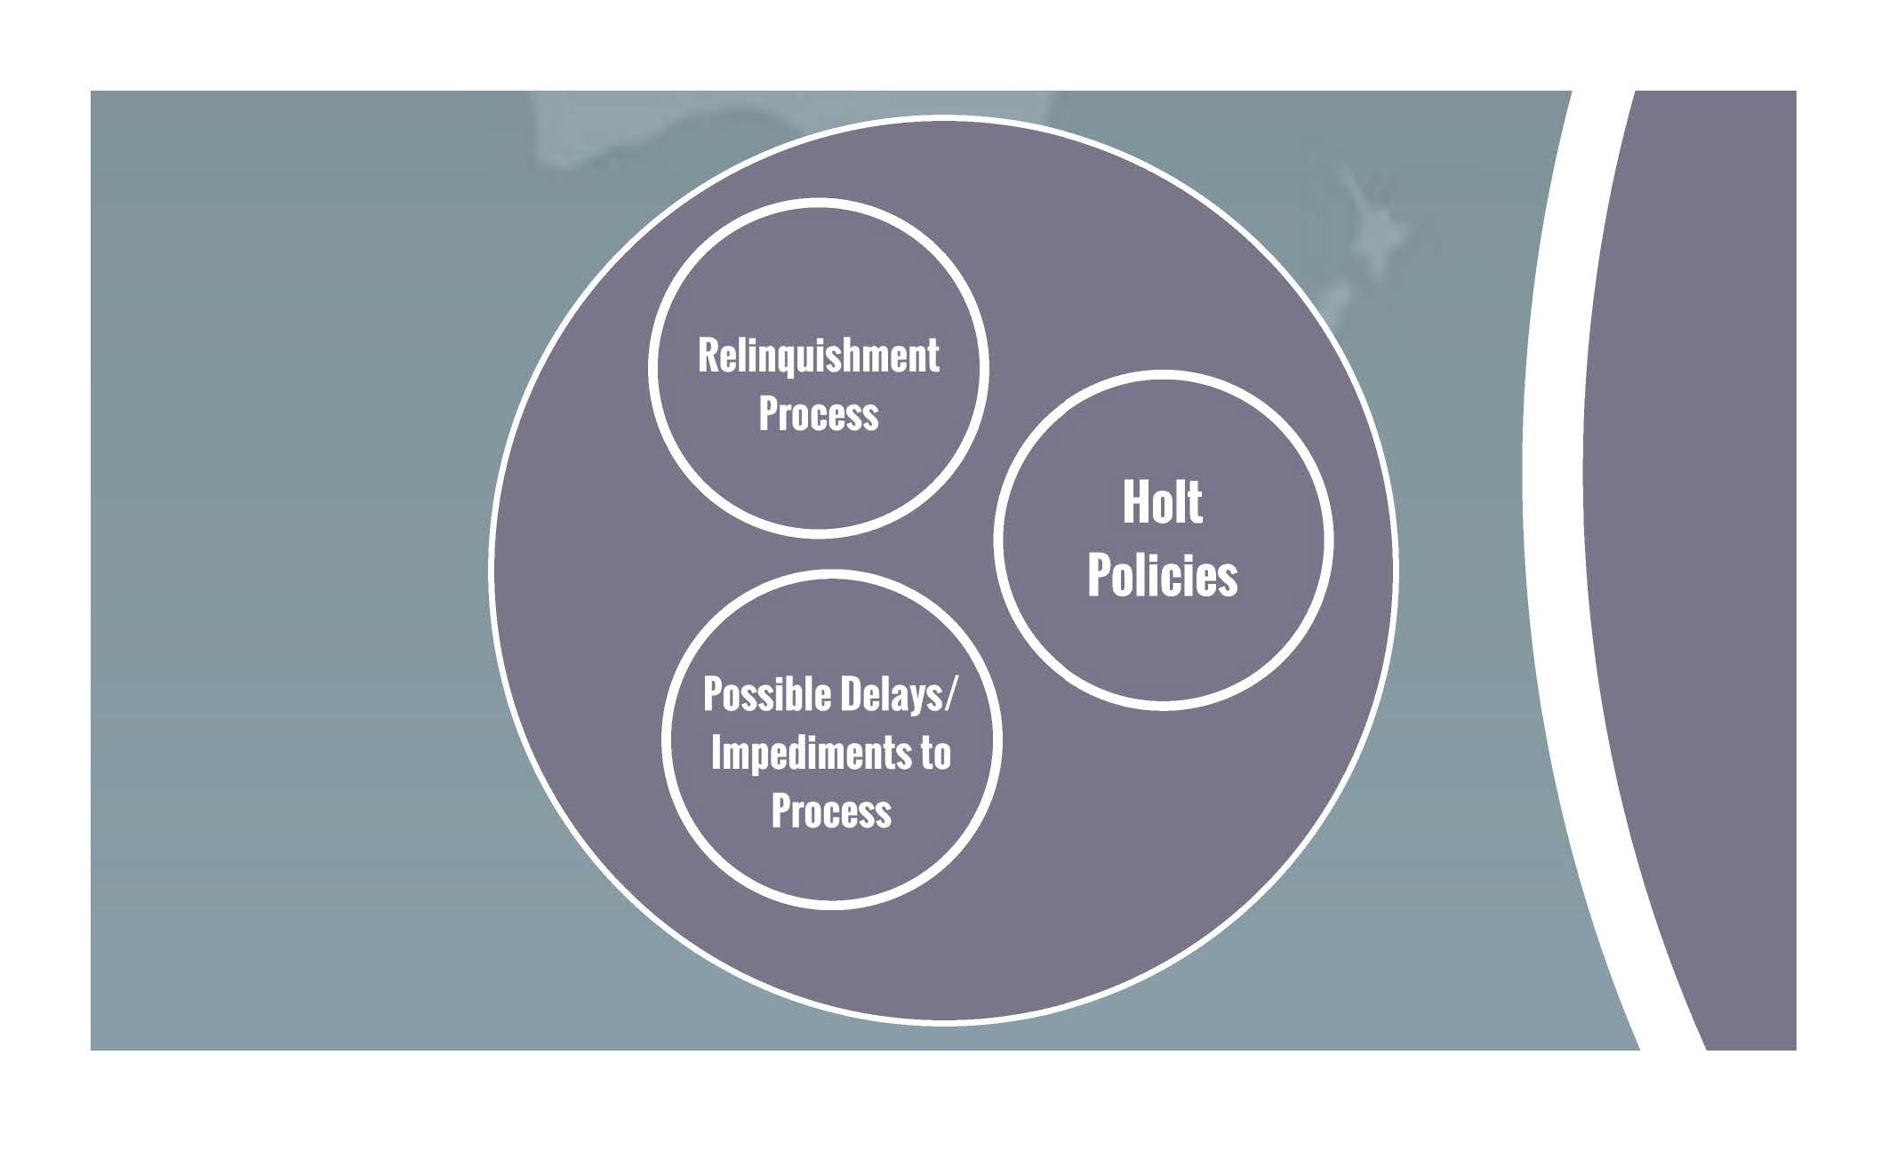
Notes:
Taking a look at other important things to note about a Haitian adoption, let’s look at Haiti’s relinquishment process.

Slide 15
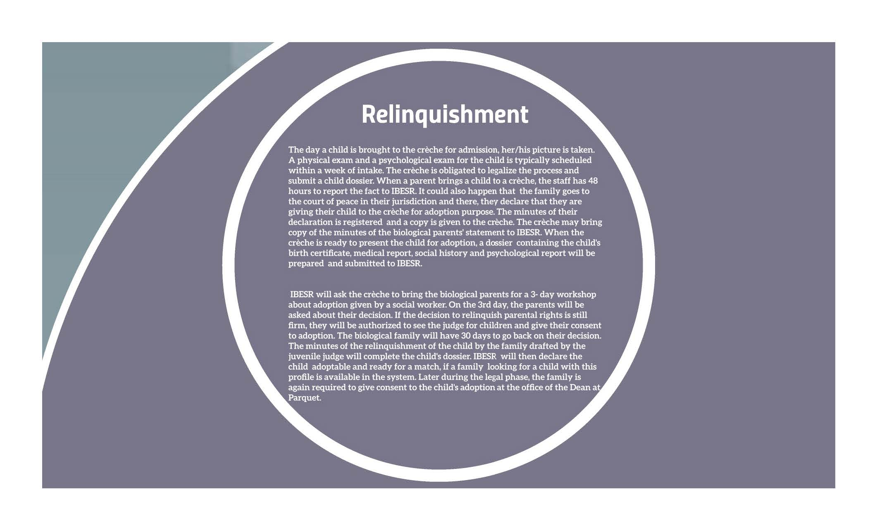

Slide 17
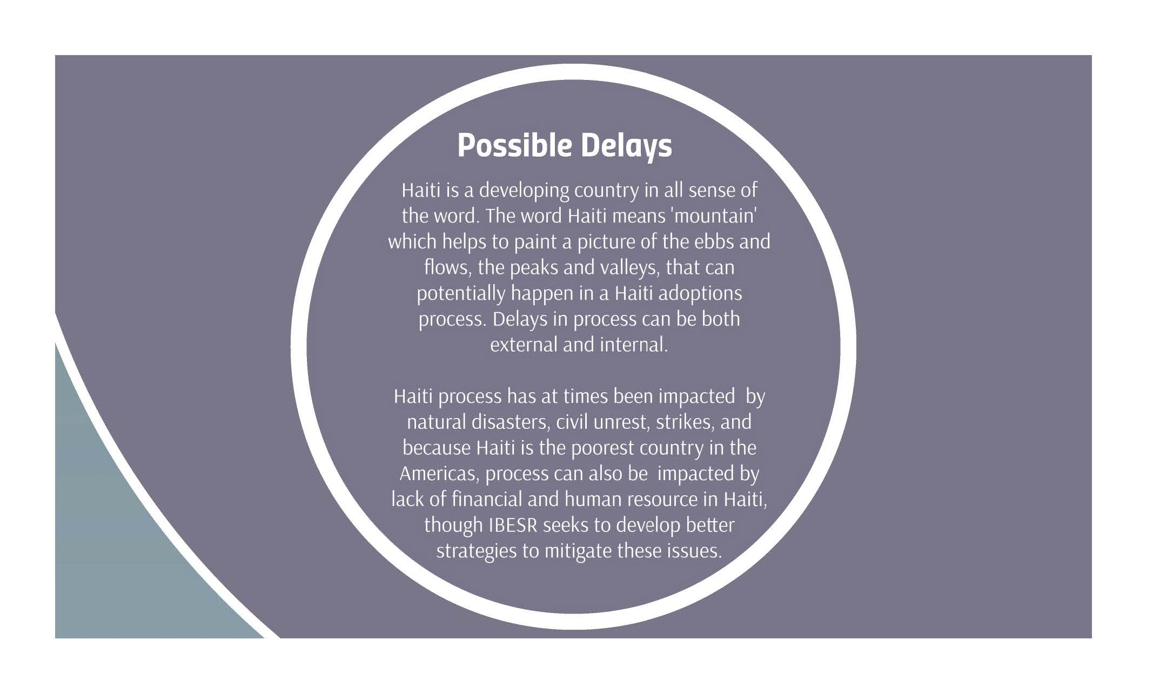

Slide 18
Impediments
Politics and Policies
  the number of children available for adoption
  the number of applications received globally
  the resources a country has for intercountry adoption
  The social, political and cultural context in overseas countries

Slide 20
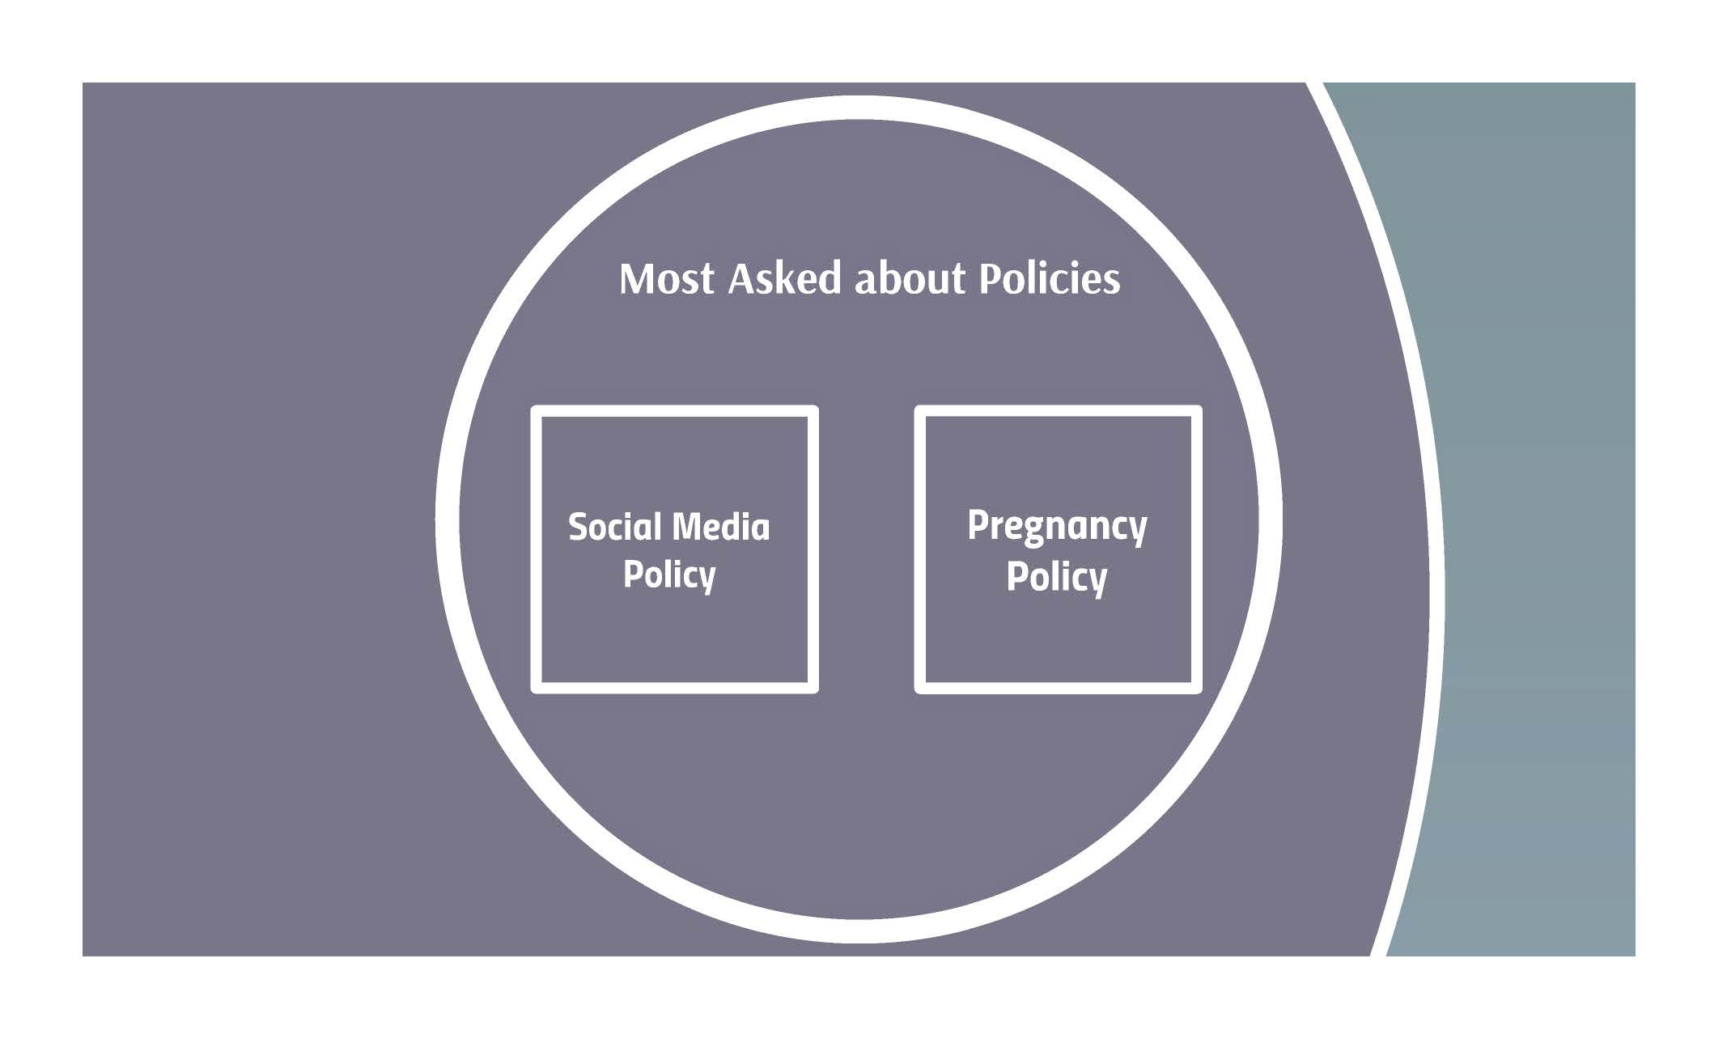

Slide 22
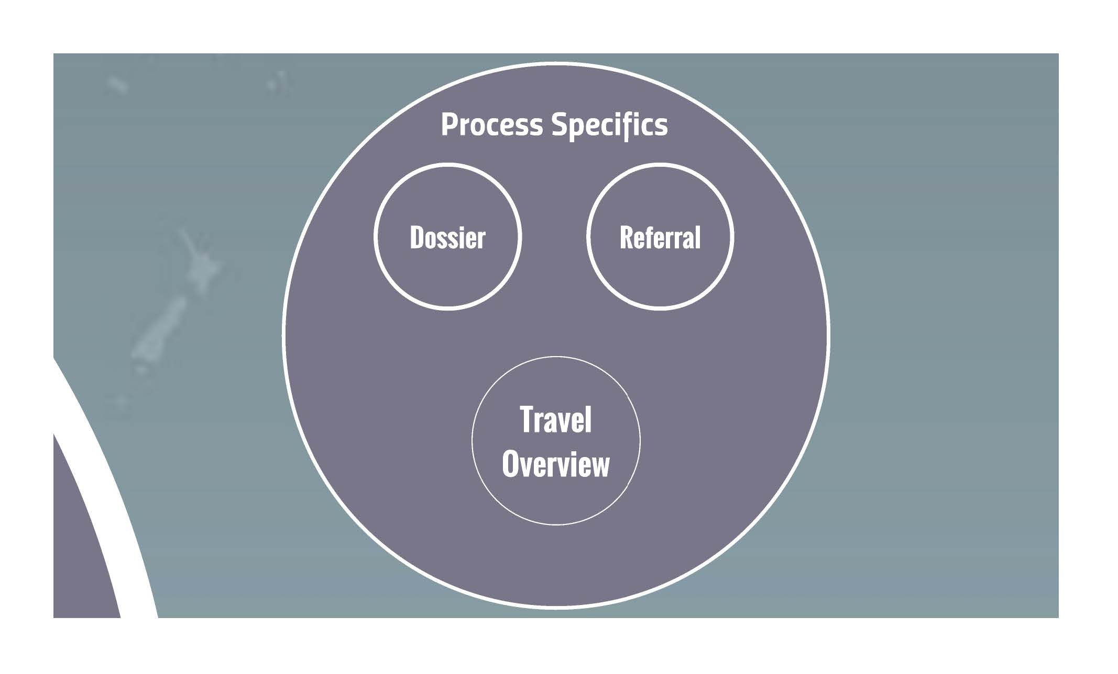

Slide 23
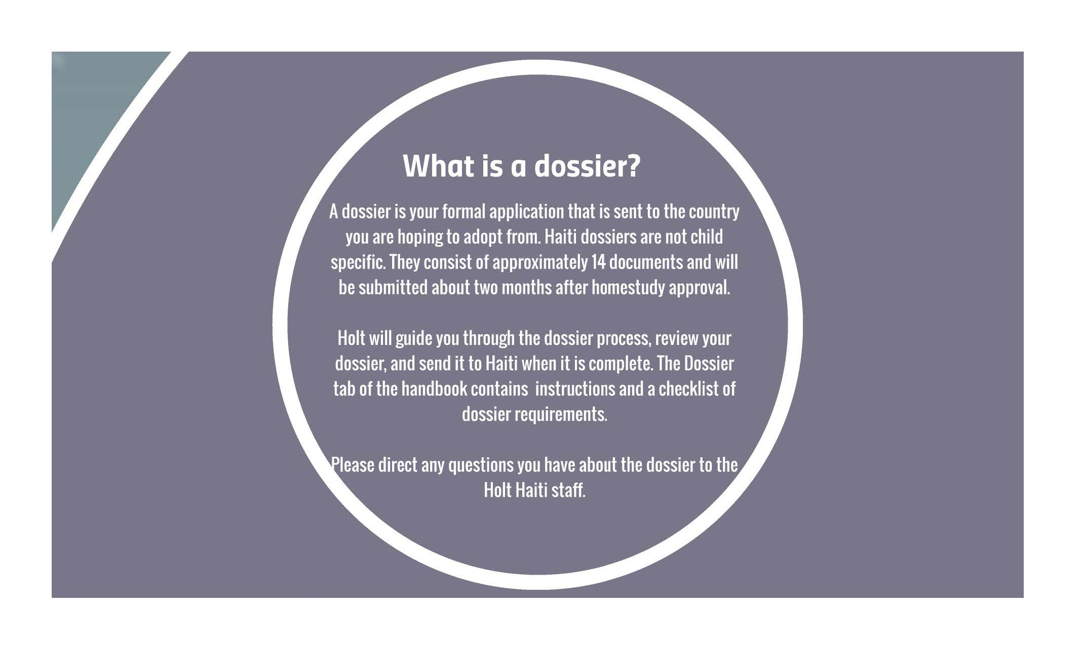

Slide 25
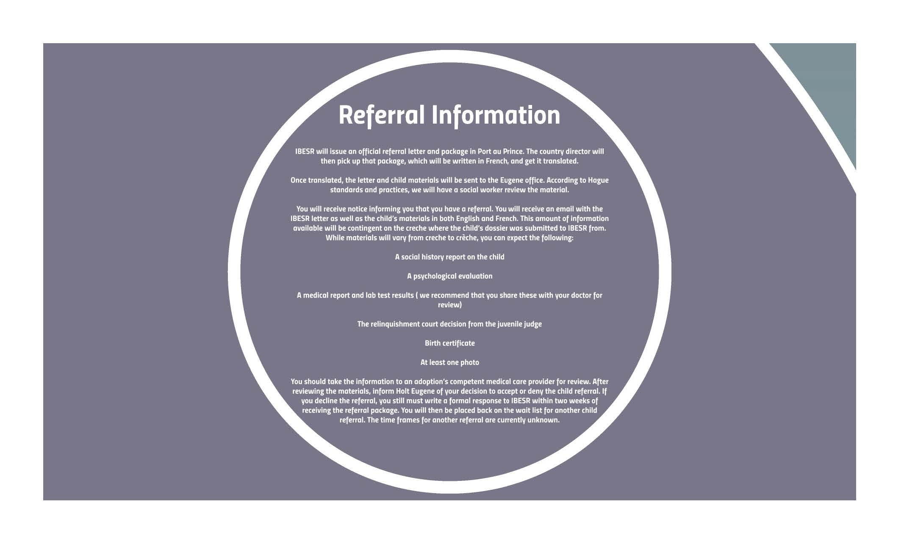

Slide 27
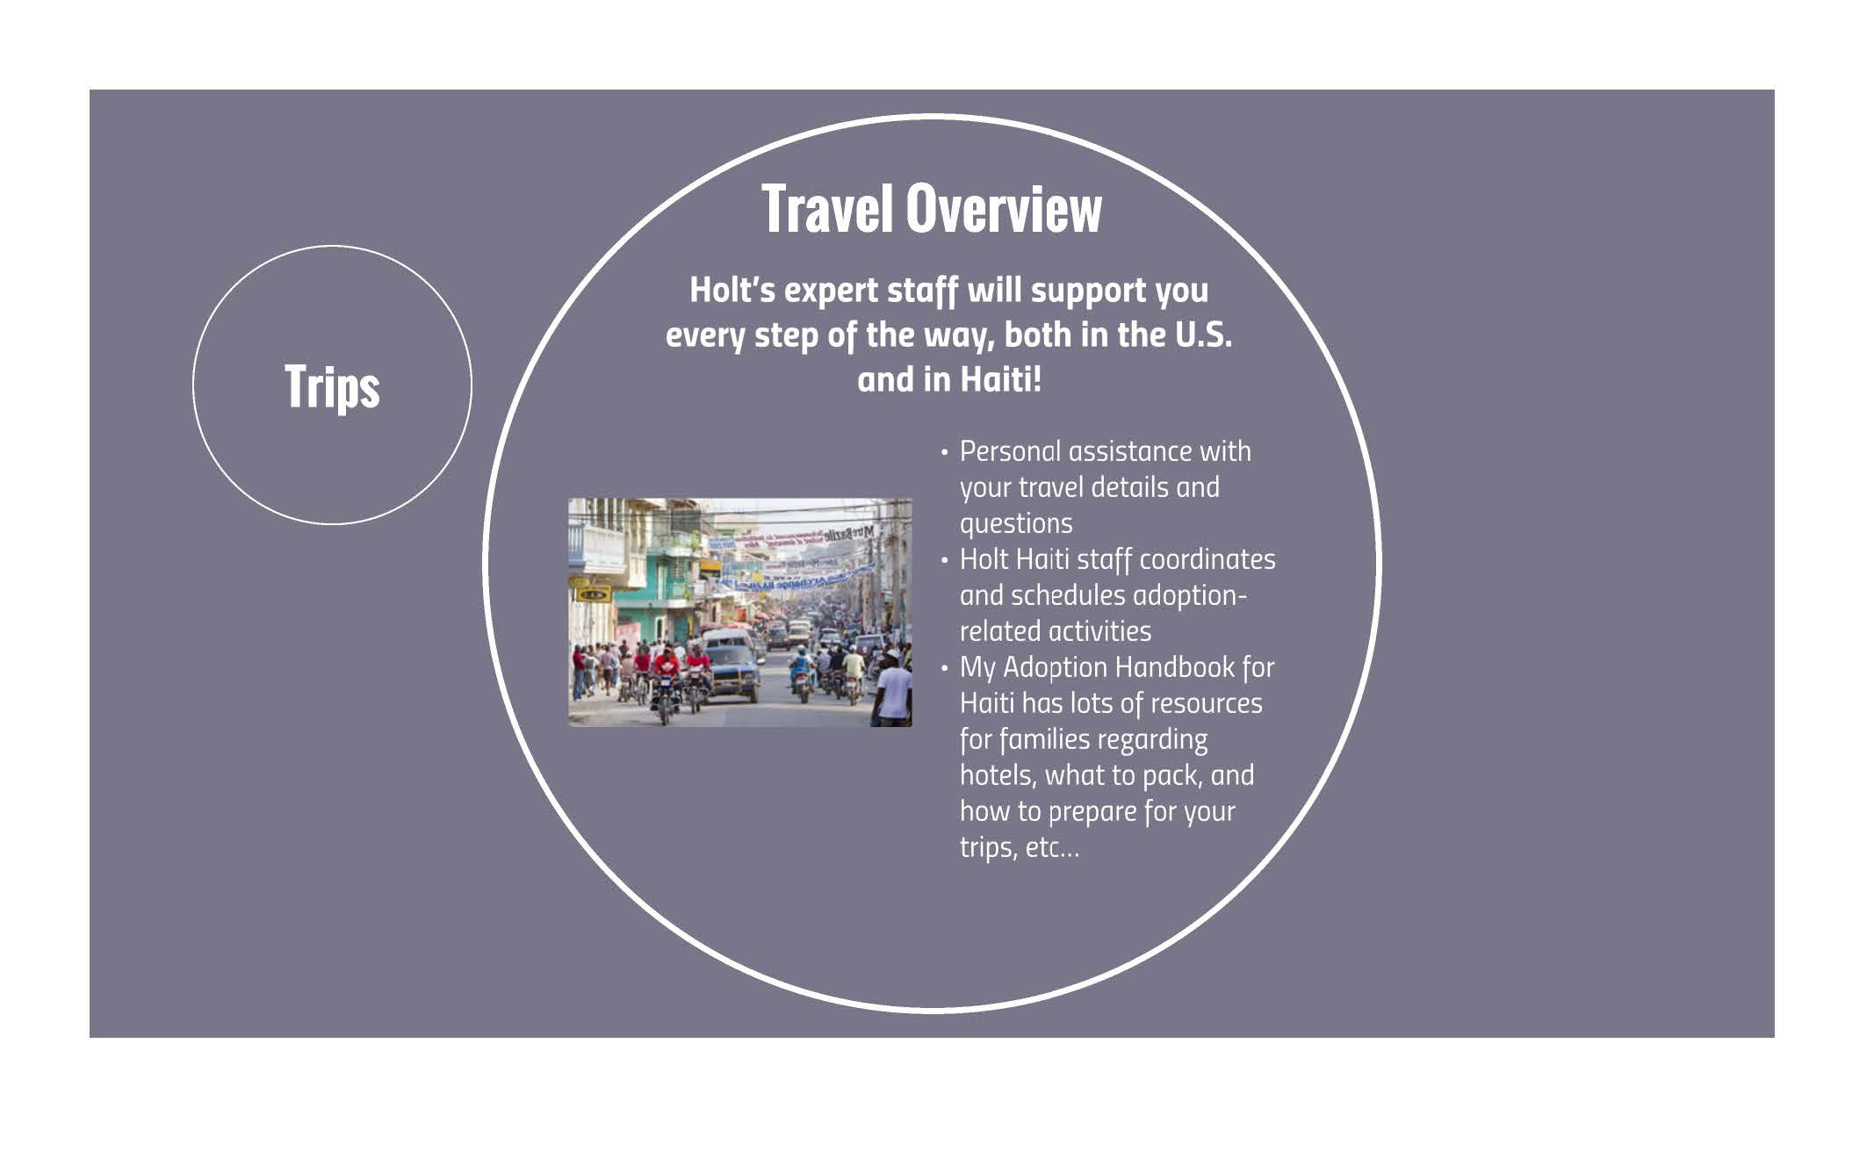
Notes:
it is important to know that every adoption process is unique, especially when it comes to travel.
We have wonderful staff that we partner with overseas.. Though you may be referred a child from a crèche outside of Port Au Prince, Holt Haiti staff will help to facilitate your time in country when you travel. I will assist you with any travel questions you may have.
When you arrive in country Holt Haiti staff will help coordinate and schedule all adoption related activities and lend their personal knowledge of accommodations, including lodging, restaurants, and transportation.
Families have flexibility to stay in the hotel of their choice during the two trips to Haiti. Due to the fact that IBESR works within their partner network, we will not know what crèche your child will be matched from until we receive the match proposal. We will do our best to collect information on that crèche before you travel.

Slide 28
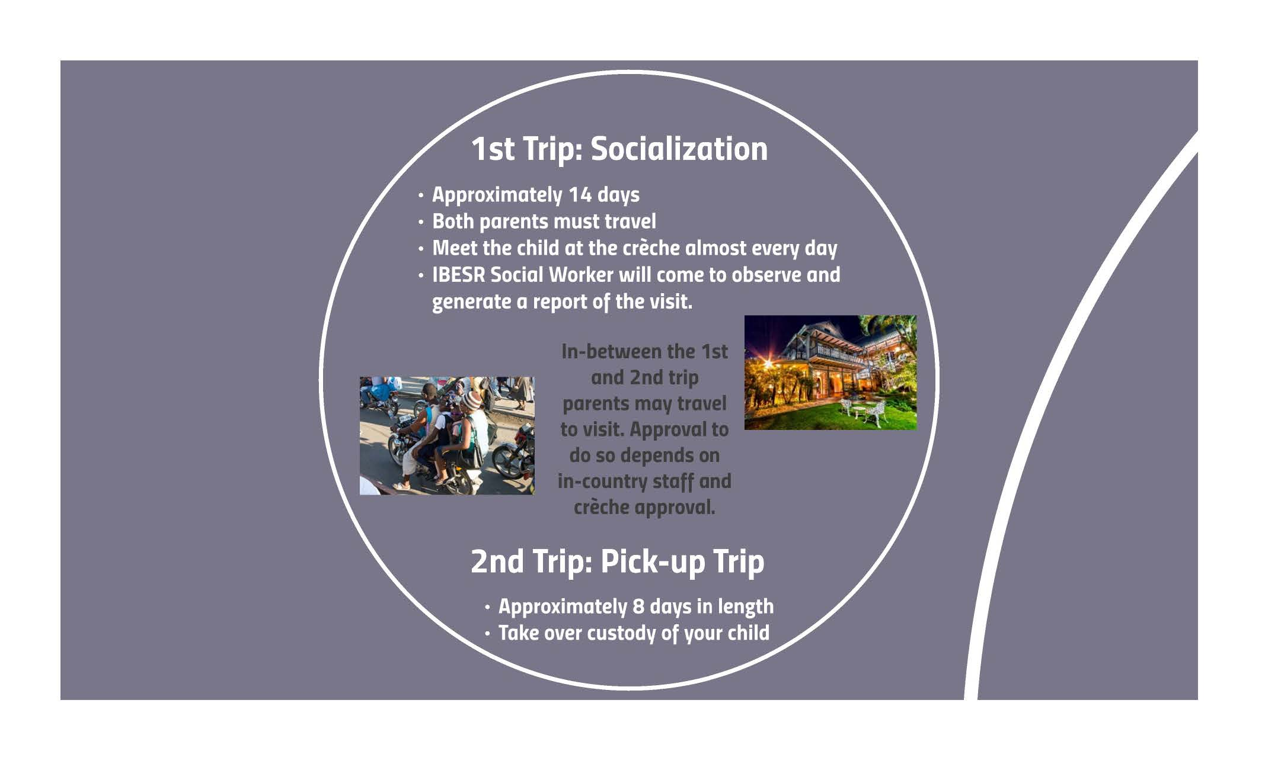
Notes:
The first trip, known as the socialization trip, is approximately 2 weeks. Both adoptive parents are required to travel and will visit the child at the crèche each day you are in Haiti. During the 2nd week IBESR will send a social worker to observe your interactions and to report back to IBESR.
Timeframes vary between the first and the second trip. Again, depending on adoptive parent availability and finances, you are allowed to travel to visit your child between the 1st and 2nd trip.
The second trip is approximately 7-9 days. The length of this trip will be dependent on what day of the week and time of the day you arrive. This is a mandatory trip to take over custody of your child.

Slide 30
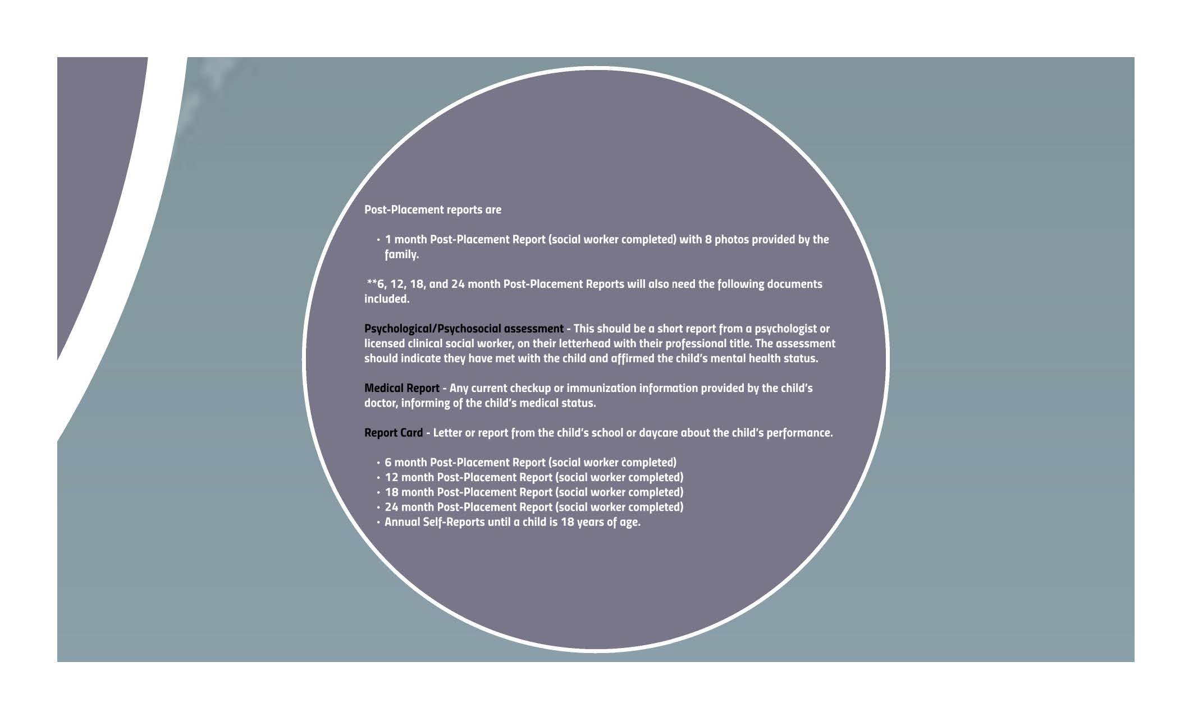
All reports MUST include 8 -10 photos
Notes:
Haiti’s Post-Placement schedule is highlighted here. The post-placement social worker reports are due at month’s 1, 6, 12, 18 and 24. There are supplemental documents that are required to be submitted alongside the post-placement reports, as well as 8 -10 photos. After the social worker post-placement reports are conducted, Annual Self-Reports, which are generally 1 page documents written by the family, are to be submitted every year until the child turns 18.

Slide 31


Slide 32
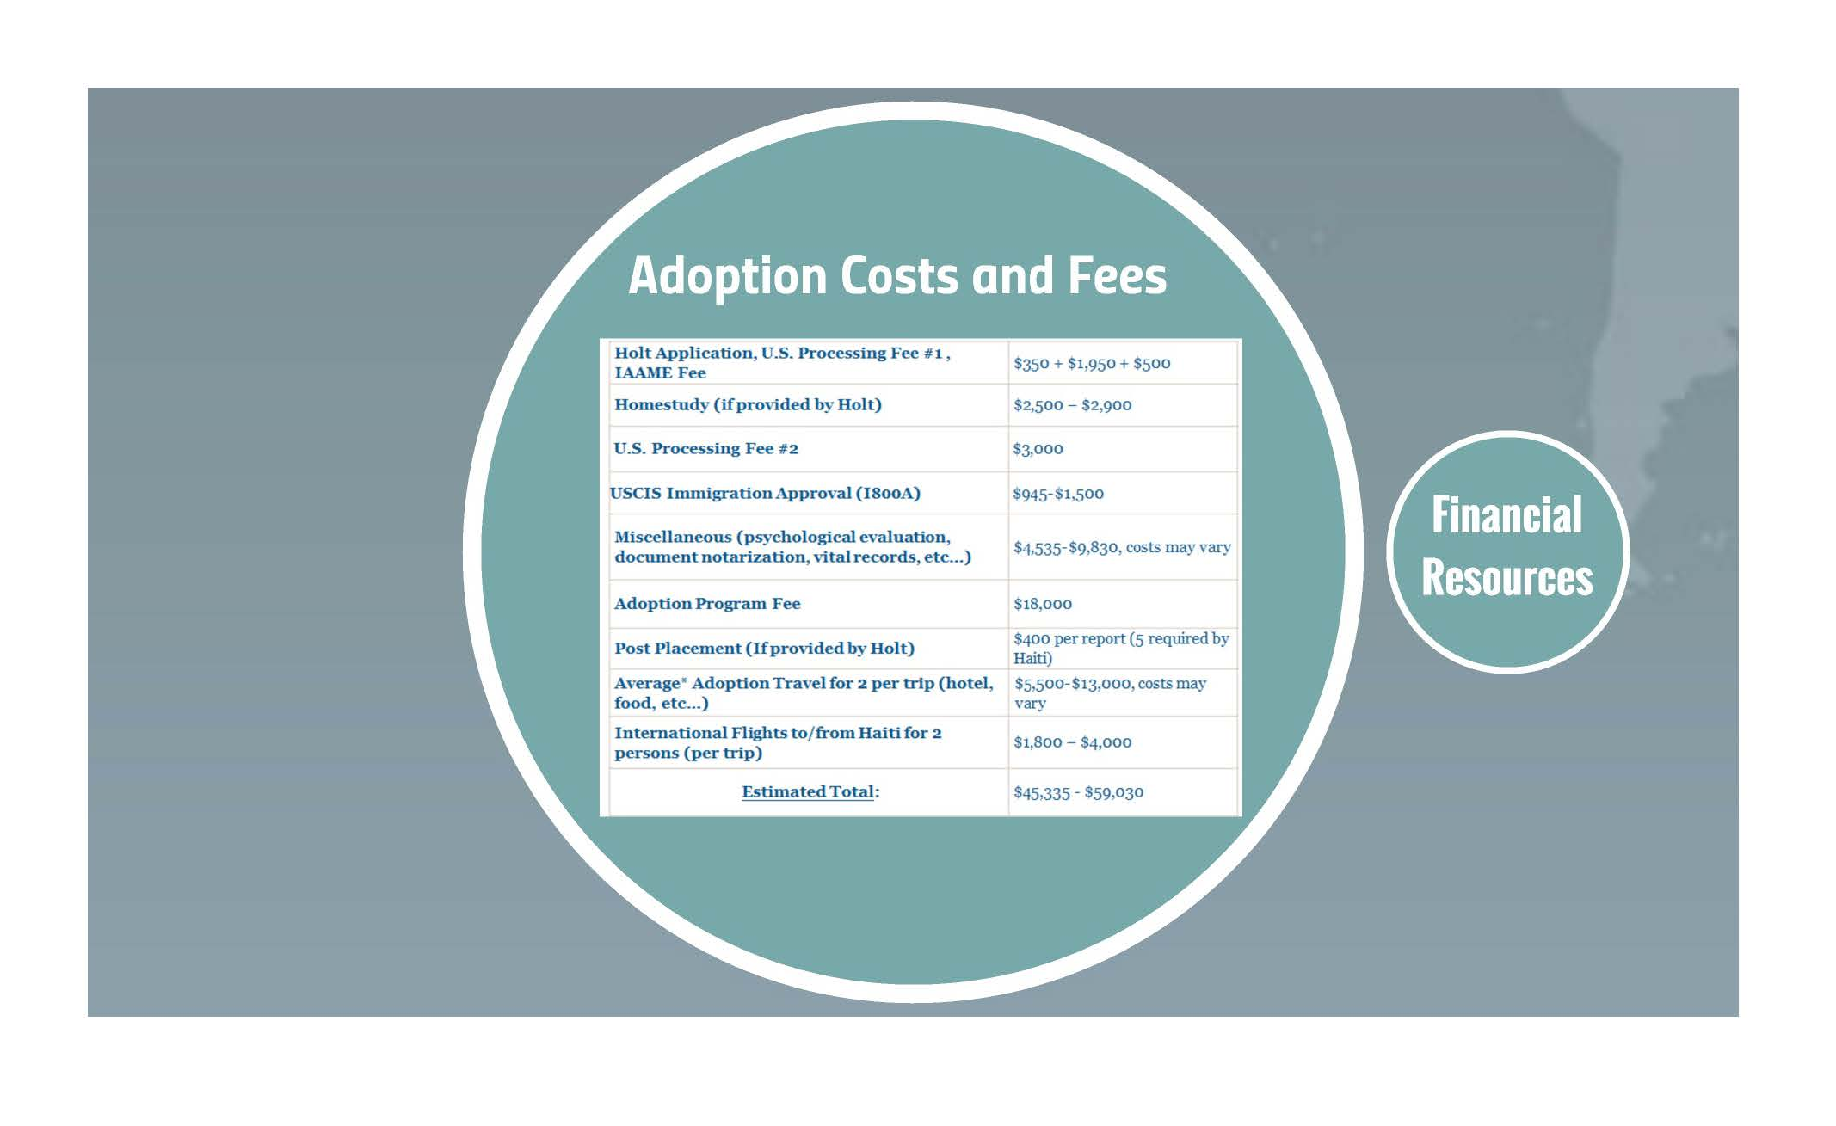

Slide 33
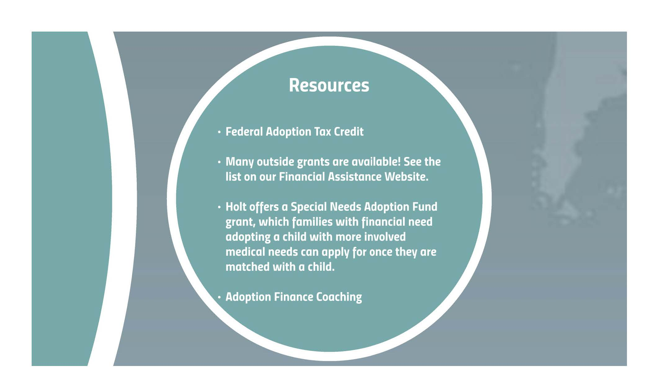

Slide 34


